Slide 1
APPAREL CLASSIFIER
By,
Saaketh Jella
Shafahad Shaik
Anand Chintakayala

Slide 2
INTRODUCTION
Apparel Classifier is an artificial neural network model that classifies grayscale images of size 28x28 px and provides the category of the image like shirt, footwear etc.
We used a clothing fashion dataset which is completely developed by us.
The dataset contains 10,714 images over four categories which are Footwear, Handbags, Shirts, T-shirts.
Our model has an accuracy of around 85%.
Our graph shows constant increase of accuracy and decrease of loss on getting more data.
Our project is an open-sourced project so all the codes will be available on GitHub.

Slide 3
TECHNICAL DETAILS
Libraries: TensorFlow, Keras, Matplotlib, NumPy
Activation Function: ReLU
Dataset: Our own dataset
Languages: Python
IDE’s and Text editors: Google Colab, Sublime Text, VS code

Slide 4
DEVELOPMENT OF DATASET
The images of clothing consisting various categories was downloaded and categorized.
Then the cleaning of images has been done.
After cleaning the images they have been converted to the grayscale images.
Those grayscale images have been all pixelized to the size of 28x28 px.
After converting all the images to grayscale of size 28x28 px they have been categorized into two datasets. Those are:
i. Train dataset
ii. Test dataset

Slide 5
DEVELOPMENT OF DATASET
Test images and train images folder are converted to .npz file which is supported by the model to feed the data.
Then the .npz files are converted into .csv format so that they can be label encoded.
The cells consisting of categorical data from those .csv files will be label encoded accordingly:
i. 0 – Footwear
ii. 1 – Handbags
iii. 2 – Shirts
iv. 3 – T-shirts
Once the labelling is done, the labels will be extracted and converted into .npz files.

Slide 6
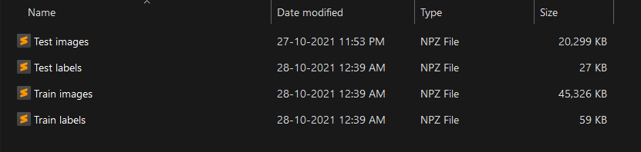
DEVELOPMENT OF DATASET
After converting the labels to npz, we will be having four file which will be fed to the model to test and train. Those files are:
i. Train images.npz
ii. Train labels.npz
iii. Test images.npz
iv. Test labels.npz

Slide 7
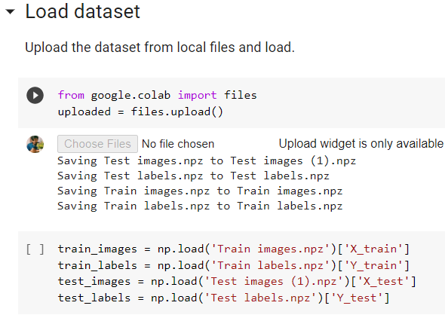
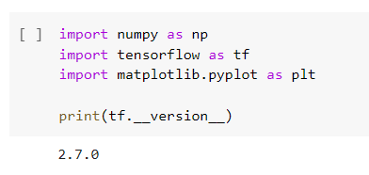
MODEL DEMONSTRATION
Importing the modules
Loading the dataset

Slide 8
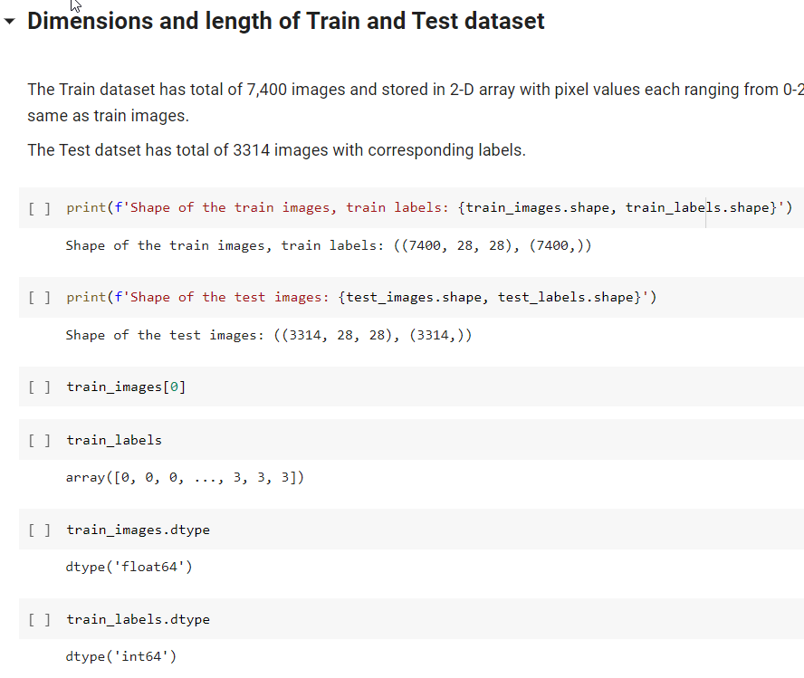
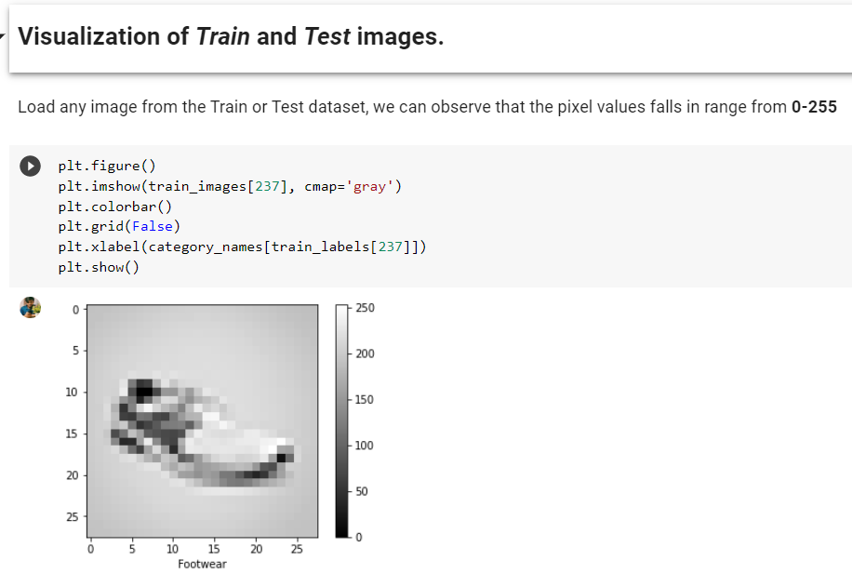
MODEL DEMONSTRATION
Dimensions
Visualization of Train and
Test images

Slide 9
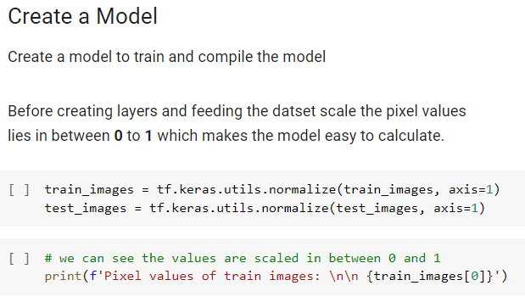
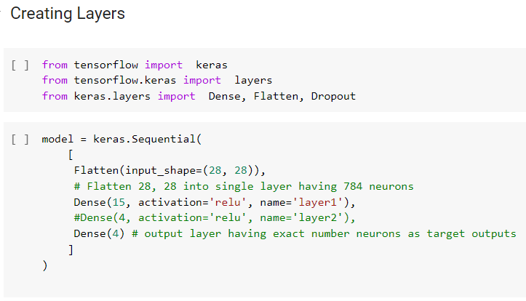
MODEL DEMONSTRATION
Creating the Model
Creating Layers

Slide 10
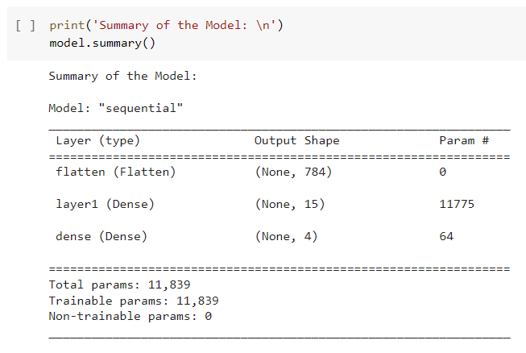
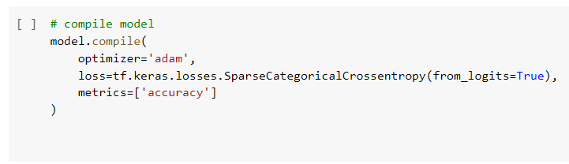
MODEL DEMONSTRATION
Summary
Compiling the Model

Slide 11
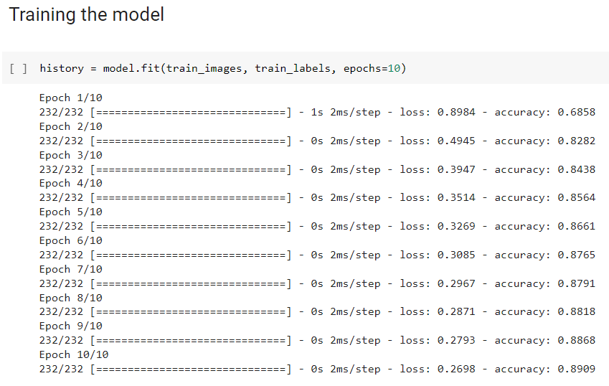
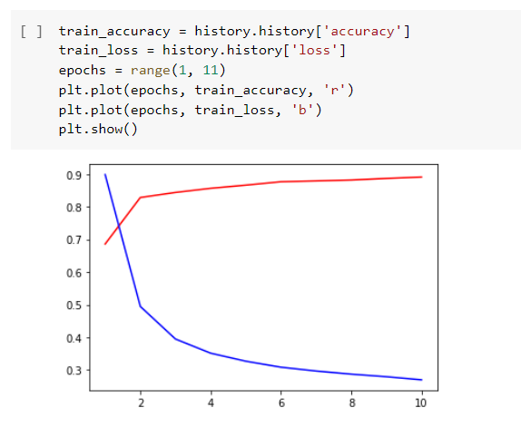
MODEL DEMONSTRATION
Training the Model
Train accuracy and loss graph

Slide 12
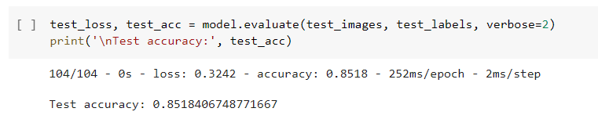
MODEL DEMONSTRATION
Testing loss and accuracy

Slide 13
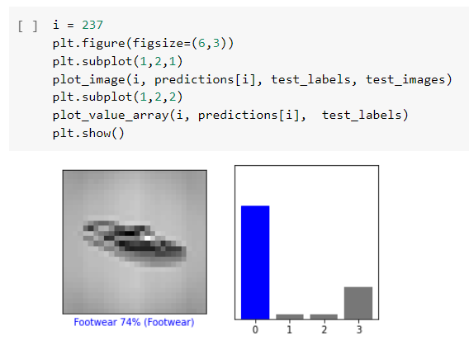
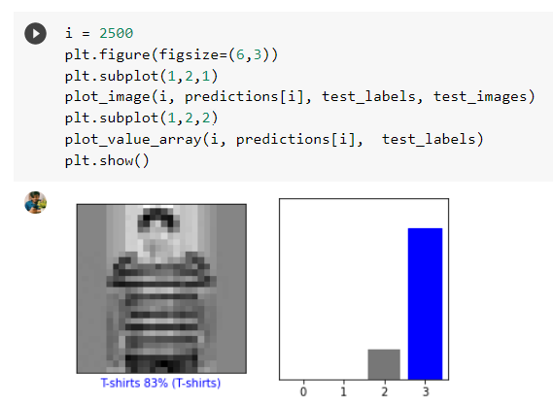
MODEL DEMONSTRATION
Testing the model – 1
Testing the model – 2

Slide 14
Conclusion
By this neural network model, we categorized different images of clothing (Footwear, Handbags, Shirts, T-shirts).
This model makes the predictions based on the pixel values of the images.
Among the four categories, maximum accuracy was achieved by Footwear, Handbags, T-shirts.
The accuracy of model is affected by the present of model(human) in the images as the model takes the pixel values of model(human) face, hands etc.
The accuracy of model can further be improved by removing the images containing models(human).

Slide 15
THANK YOU

